Slide 1

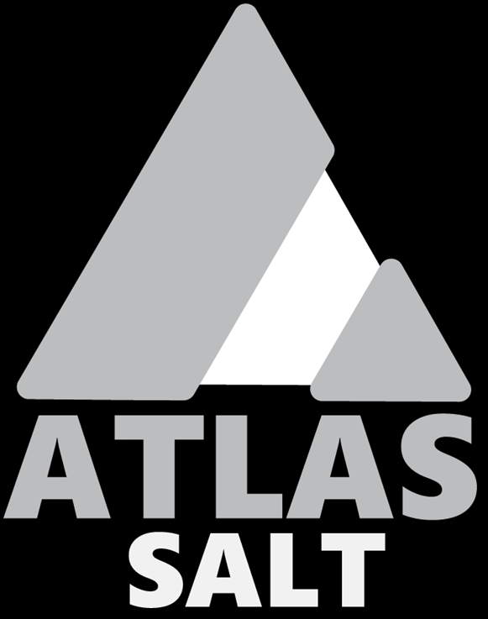
Strategic location.
Innovative design.
TSXV: SALT | OTCQB: REMRF
Sustainable mining.
September 2024

Slide 2
Disclaimer: Forward Looking Statements
This presentation includes certain “forward-looking information” and “forward-looking statements” (collectively “forward-looking statements”) within the meaning of applicable Canadian securities legislation. All statements other than statements of historical fact included herein, including without limitation statements relating to the future operating or financial performance of the Company, are forward-looking statements. Forward-looking statements are frequently, but not always, identified by words such as “expects”, “anticipates”, “believes”, “intends”, “estimates”, “potential”, “possible”, and similar expressions, or statements that events, conditions, or results “will”, “may”, “could”, or “should” occur or be achieved. Forward-looking statements in this presentation relate to, among other things: completion, delivery and timing of project components and requirements, and analysis and assumptions related thereto. Actual future results may differ materially. There can be no assurance that such statements will prove to be accurate, and actual results and future events could differ materially from those anticipated in such statements. Forward-looking statements reflect the beliefs, opinions and projections on the date the statements are made and are based upon a number of assumptions and estimates that, while considered reasonable by the respective parties, are inherently subject to significant business, technical, economic, and competitive uncertainties and contingencies. Many factors, both known and unknown, could cause actual results, performance or achievements to be materially different from the results, performance or achievements that are or may be expressed or implied by such forward-looking statements, and the parties have made assumptions and estimates based on or related to many of these factors. Such factors include, without limitation: the timing, completion and delivery of required permits, supply arrangements and financing. Readers should not place undue reliance on the forward-looking statements and information contained in this news release concerning these times.
Except as required by law, the Company does not assume any obligation to update the forward-looking statements of beliefs, opinions, projections, or other factors, should they change.
Qualified Person
The scientific and technical information contained in this presentation was approved by Andrew Smith, P. Eng., the Company’s Project Manager for the Great Atlantic Salt Project and a "Qualified Person" under National Instrument 43-101.
Neither the TSX Venture Exchange nor its Regulation Services Provider (as that term is defined by the TSX Venture Exchange) accepts responsibility for the adequacy or accuracy of this presentation.
All values in Canadian dollars unless noted. Some figures are rounded.

Slide 3
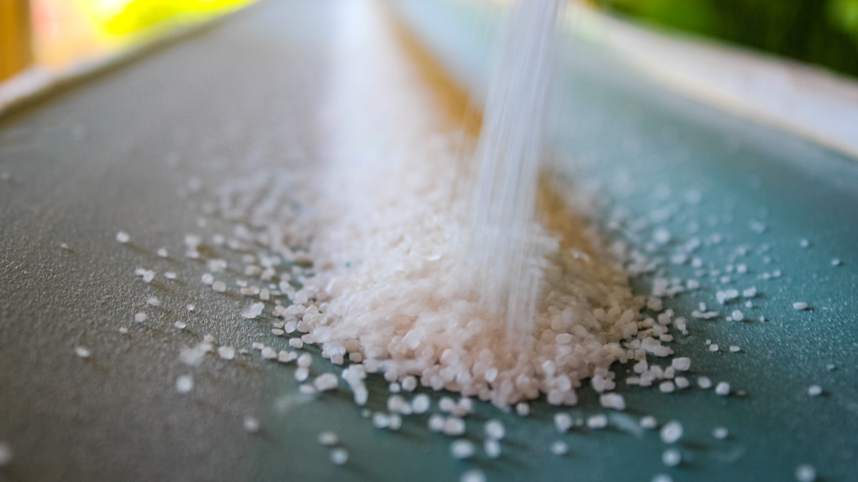
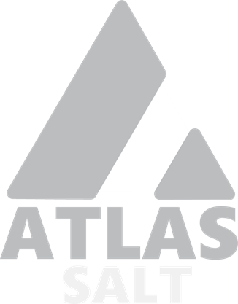
A unique & differentiated story
Strategic location.
Innovative design.
Sustainable Mining.
World class resource.
Advancing towards construction.
Low GHG impact.
TSXV: SALT | OTCQB: REMRF | FSE: 9D00

Slide 4







At a glance
Location
Advancing the Asset
SALT
$0.62
Western Newfoundland
Bay St. George Basin (~25 km south of the Town of Stephenville)
Permitting – post-environmental assessment stewardship, regional zoning, surface leasing.
Robust Economics & Constructability - independent Feasibility Study released by SLR Consulting.
Low Emission - independent GHG Study released by Stantec Consulting.
Economic Impact – independent Impact Study released by Jupia Consultants.
Validated Productivity – independent mine simulation and modeling verification completed by SRK Consulting.
De-risked Development Schedule - independent review and verification by Tamkali Limited.
TSXV code
Share price as of
December 31, 2024.
Infrastructure
Multiple Logistical Advantages
Nearby deep water port
Hydroelectric, high voltage power
$60M
$8M
Market capitalization as of December 31, 2024
Cash on hand as of December 31, 2024.
Innovation –battery electric vehicles & overland conveyor system.
St. Johns,
NL, Canada
Strategic
34 yr¹
Salt Offtake & Canadian JV
Non-binding MOU with Scotwood Industries
Targeted volume of 1.25 to 1.50 Mtpa of packaged salt and related products
Mine life
Head Office
1.0B¹
0.6B¹
Pre-Tax
NPV (8%)
After-Tax
NPV (8%)
Equipment Partnership
Non-binding MOU with
Sandvik Mining and Rock Solutions, including $73 million financing
¹ Feasibility Study (FS) prepared by SLR Consulting (Canada) Ltd. (SLR) for the Great Atlantic Salt Project disclosed in a technical report filed on SEDAR on May 1, 2024.

Slide 5
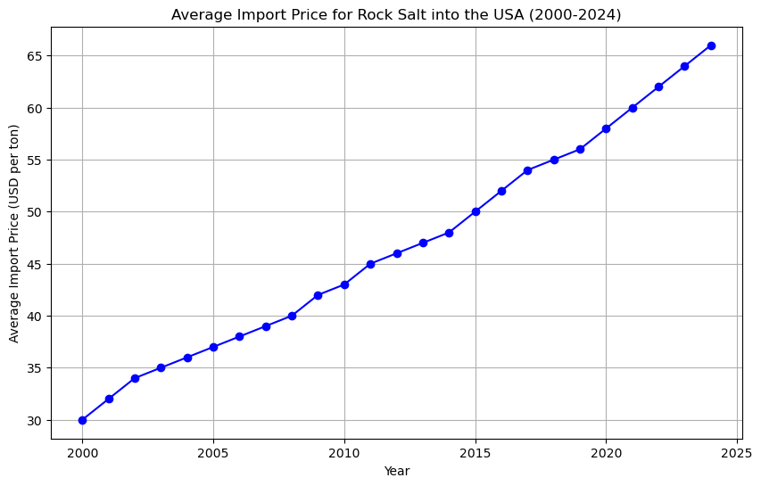
North American salt industry
International Supply Breakdown¹
Demand by End Markets¹
Global demand of over 325 Mtpa
North America demand of 70 Mtpa
  18 Mtpa imported annually (25%)
    Primary regions include Chile, Mexico, Egypt, Brazil
  Imports grown from 7-10 Mtpa in 2010-2013 to current levels
De-icing
Geographic Supply¹
15-20 million tonnes imported annually to North America
Stable Price Growth²
Target End Markets
Primary Focus: De-icing
Regions
  Atlantic Canada
  Eastern Canada
  Northeastern US
Market Segments
  Bulk Commercial
  Packaged Commercial
  Packaged Consumer
Secondary Focus
  Review underway
Sourced from 2022 Salt Market Information Study. STEFAN SCHLAG LEON BERAUD. www.saltmarketinfo.com
Based on data from the US Geological Survey

Slide 6

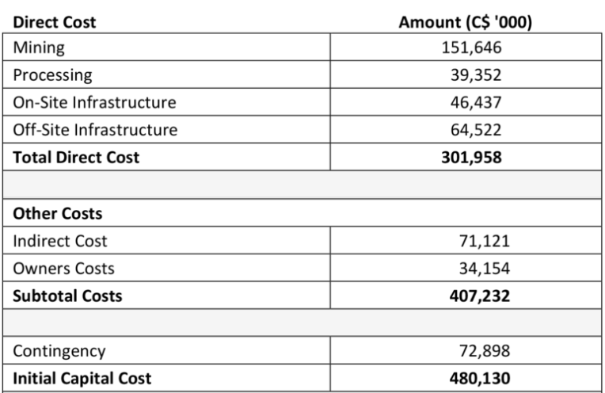
Feasibility study¹
Finalized by SLR Consulting
  underground mine and infrastructure with an integrated conveyor system
  Base case salt production of 2.5 Mtpa over a 34-year mine life
Robust economics
  After-tax IRR of 18.5%
  After-tax NPV (8%) of $553 million
  Capex of $480 million
Strong free cash flow conversion and ROIC
  4.8 year after-tax payback
  $23/ metric tonne cost of production vs. est. $72/metric tonne selling price²
Infrastructure
  Infrastructure in FS could support potential future expansions up to 4.0 Mtpa
Potential resource expansion
  868 Mt inferred resources not included in FS base case
Economic Summary - Feasibility Study¹
Capital Cost (CAPEX) Summary - Feasibility Study¹
¹ Feasibility Study (FS) prepared by SLR Consulting (Canada) Ltd. (SLR) for the Great Atlantic Salt Project disclosed in a technical report filed on SEDAR on May 1, 2024.
² Feasibility Study (FS) assumes a Q3 2023 selling price, and cost basis of $22.70 per tonne FOB Turf point port.

Slide 7
World class resource
Reserve Class¹ | Grade (% NaCl) | Tonnes (Mt) | Contained NaCl (MT)
Probable | 96.0 | 88.1 | 84.5
Ideal Shape
  Large, homogeneous and relatively shallow high-grade resource¹
High Continuity
  Resource modelling indicates a "tremendous continuity" with average thickness of 200 m
  Distance to the top of the salt formation varies from 190 m to 400 m
High-Purity Optionality
  Exhibits significant concentrations of high-grade reserves (+98% NaCl)
  Concentrated around the “pillow” shape within the broader salt horizons
Resource Class¹ | Grade (% NaCl) | Tonnes (Mt) | Contained NaCl (MT)
Indicated | 96.0 | 383 | 368
Inferred | 95.2 | 868 | 827
Cross-Section of Great Atlantic Salt Deposit Illustrating Grade Variations
¹ Probable mineral reserves totaling 88.1 Mt at 96% NaCl are included in indicated resources. The resource estimate has an effective date of May 11, 2023. 1 Feasibility Study (FS) prepared by SLR Consulting (Canada) Ltd. (SLR) for the Great Atlantic Salt Project disclosed in a technical report filed on SEDAR on May 1, 2024.
See slide 22 for further mineral resource information.
Notes:
The GAS halite has been shown from drill core observations to exhibit varying colouration ranging between white, beige, brown, orange, champagne, medium grey, and dark grey.
Colouration has not been shown to be a reliable indicator of halite quality, with grades typically ranging from 95% NaCl to 99% NaCl.

Slide 8

Priorities for 2025
Project Financing
Advancing Regulatory Compliance Programs
Geotechnical and Hydrological Site Evaluation
Production Expansion Investigation
​Salt Distribution & Monetization​
Strategic Partnerships
Site Preparation

Slide 9
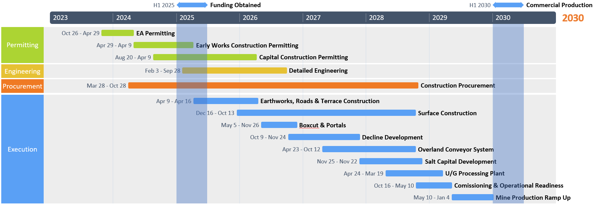
De-Risked development schedule
3rd party review and verification by Tamkali Limited
  Independent provider of Project Development and Control Services

Slide 10
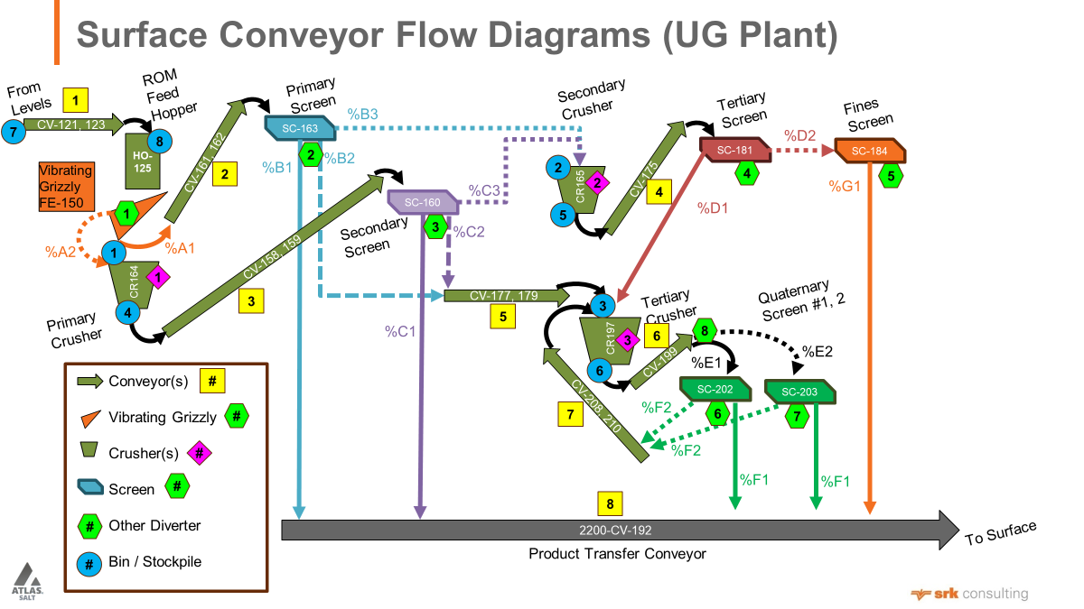
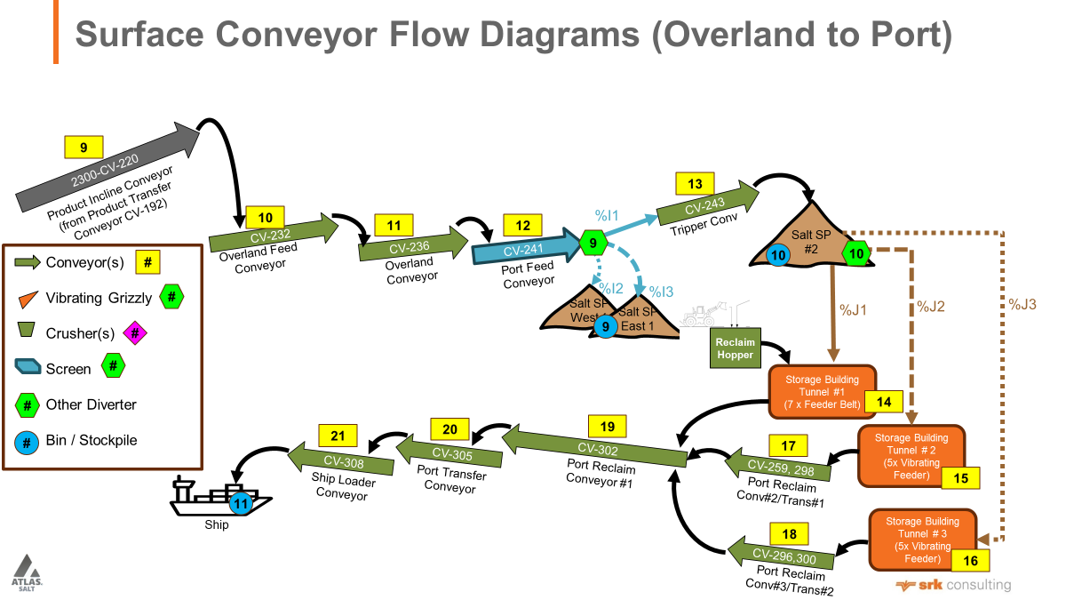
Mine simulation
Independent discrete event simulation conducted by SRK Consulting in July 2024.
Key Findings:
Resolution of SLR Consulting ¹ Recommendations:
  Reviewed continuous miner and haul truck productivity
  Optimized mining sequences to maximize productivity
  Further evaluated haul trucks for cycle times and battery life
Mobile Mining Equipment Scalability:
  Confirms viable OEM solutions for higher production values
  Planned infrastructure supports initial 2.5 Mtpa production rate, with potential for higher rates
Material Handling System and Port Capability:
  Verifies system and port can manage at least 2.5 Mtpa
  Ensures minimal disruptions and efficient material handling
¹ Feasibility Study (FS) prepared by SLR Consulting (Canada) Ltd. (SLR) for the Great Atlantic Salt Project disclosed in a technical report filed on SEDAR on May 1, 2024.

Slide 11

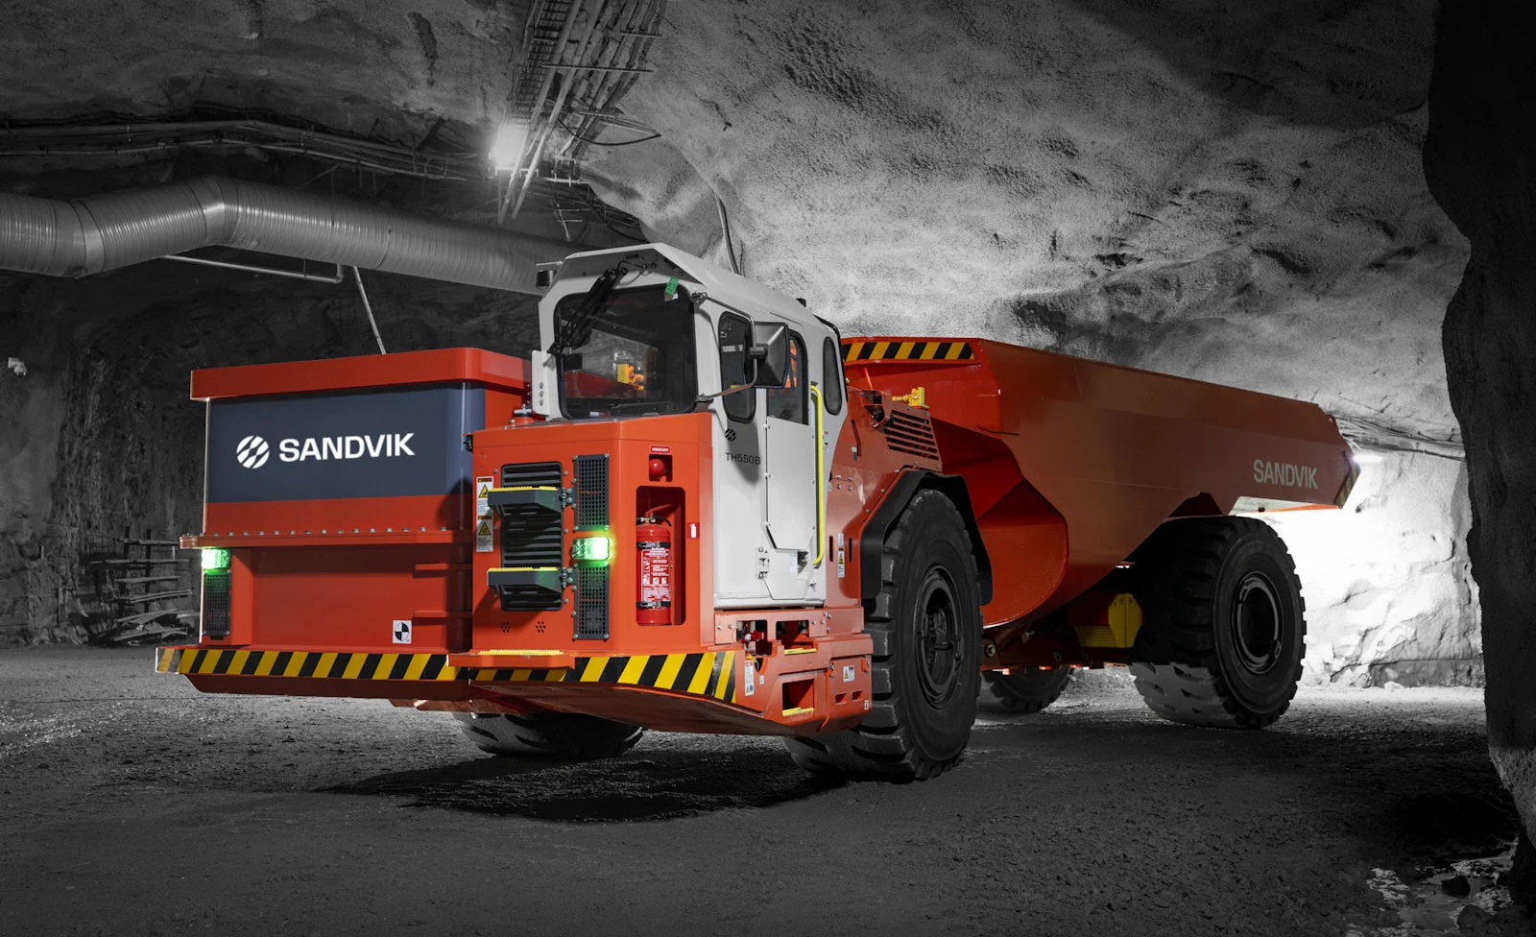
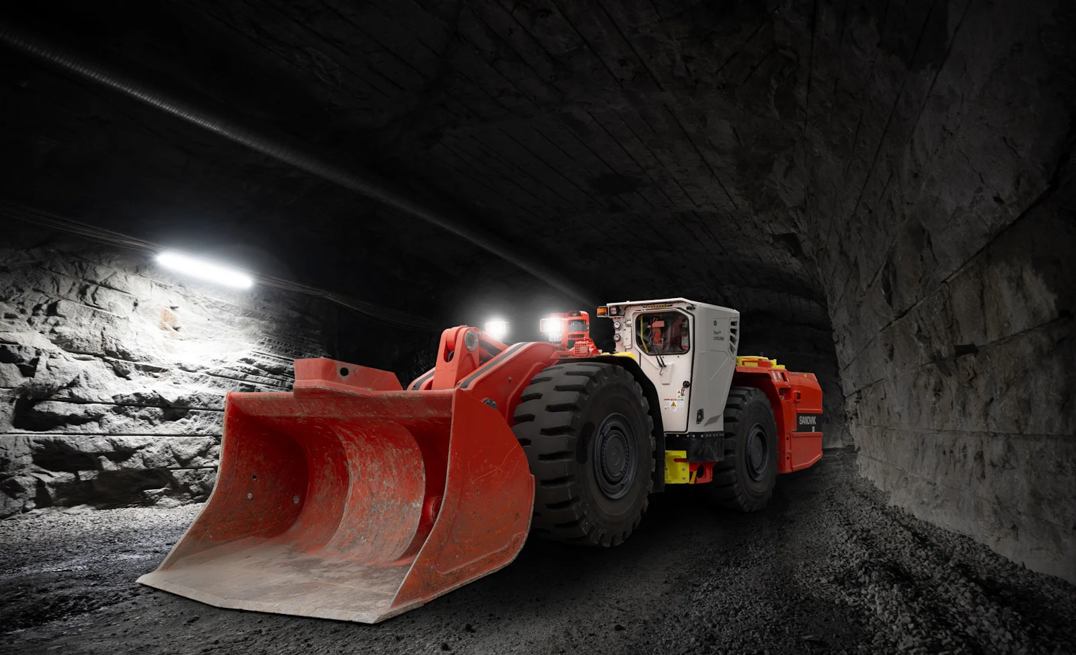
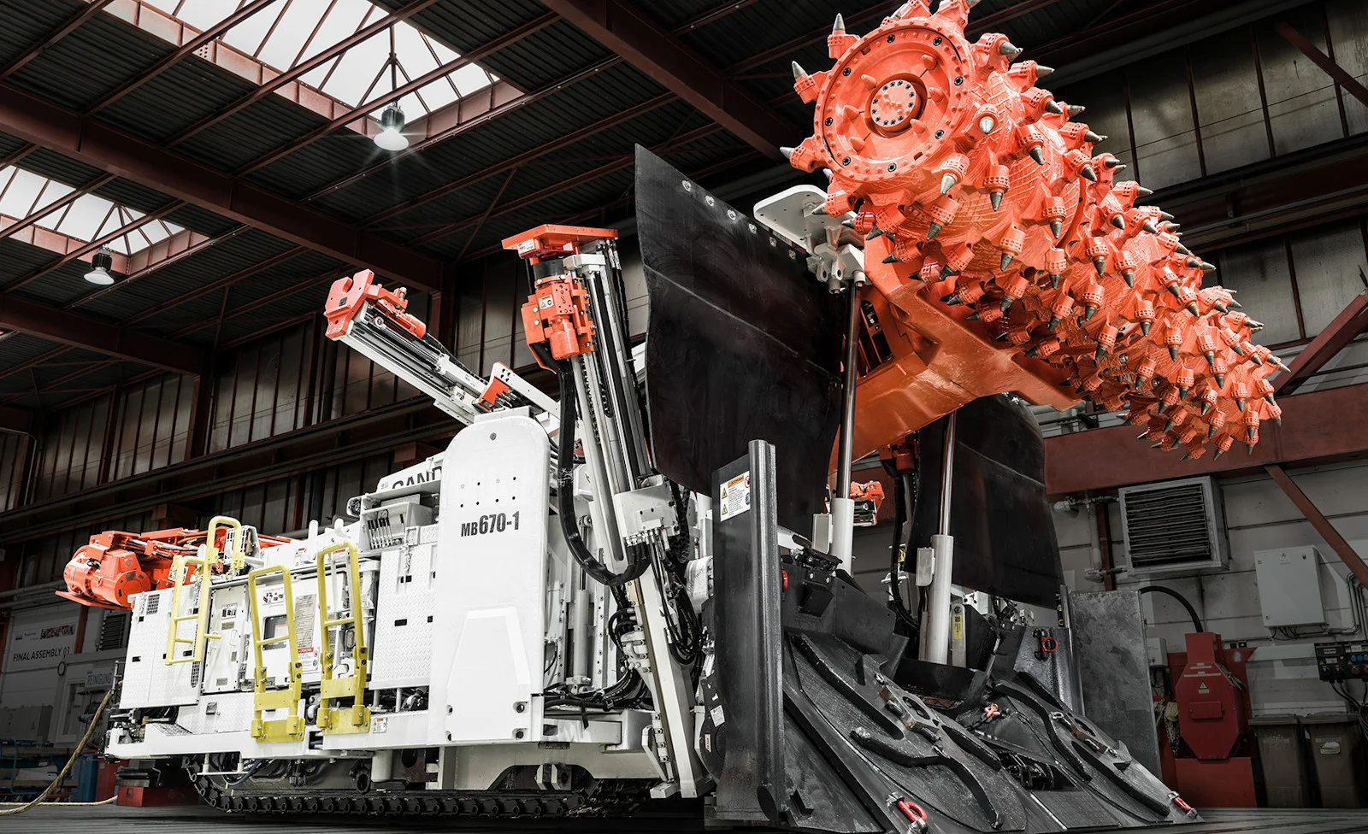
Underground equipment
Non-binding MOU with Sandvik Mining & Rock Solutions (September 2024):
Overview:
  Establishes Sandvik as the preferred equipment supplier and integrated project delivery partner
  Sandvik to establish local warehousing facilities in Newfoundland
Advanced electric mining equipment & automation:
  Battery-electric fleet: continuous miners, haul trucks, scooptrams
  AutoMine® system: tele-remote and autonomous operation
Sustainability & innovation:
  Battery as a Service & full maintenance program
  Deswik mine design software and engineering consulting
  Tailored ground support through DSI Underground Group
  Optimization and monitoring through Newtrax
$73 million financing package secured:
  Financing arrangement to support the acquisition and deployment of Sandvik’s solutions
  Non-binding and subject to customary due diligence
For more information please visit rocktechnology.sandvik

Slide 12
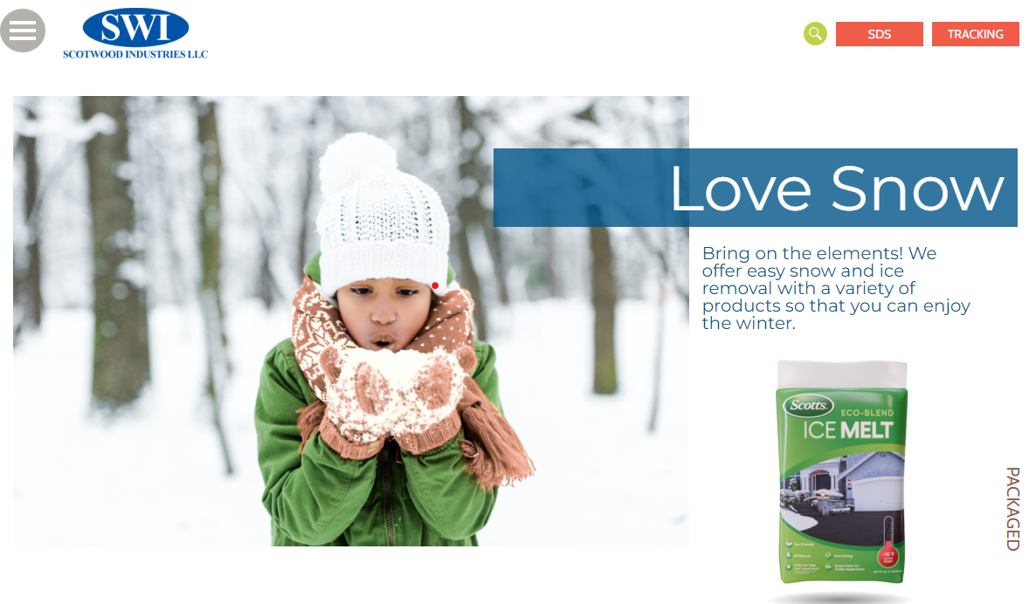
Salt production offtake and Canadian JV
Non-binding MOU with Scotwood Industries (August 2024):
Joint Venture for distribution and sale of packaged salt and related products in Canada;
Joint Venture to enter into offtake with Atlas.
Scotwood Industries:
U.S. Industry leader in the marketing and distribution of salt products since 1980.
Largest packaged retail de-icing distributor in the U.S. :
  Big box mass merchandisers, DIY, farm/home, grocery, hardware and automotive chains,
  Existing relationships averaging over 20 years.
Successful marketing strategy:
  Partnerships with nationally recognized consumer brands.
For more information about Scotwood in the United States, please visit https://scotwoodindustries.com.

Slide 13
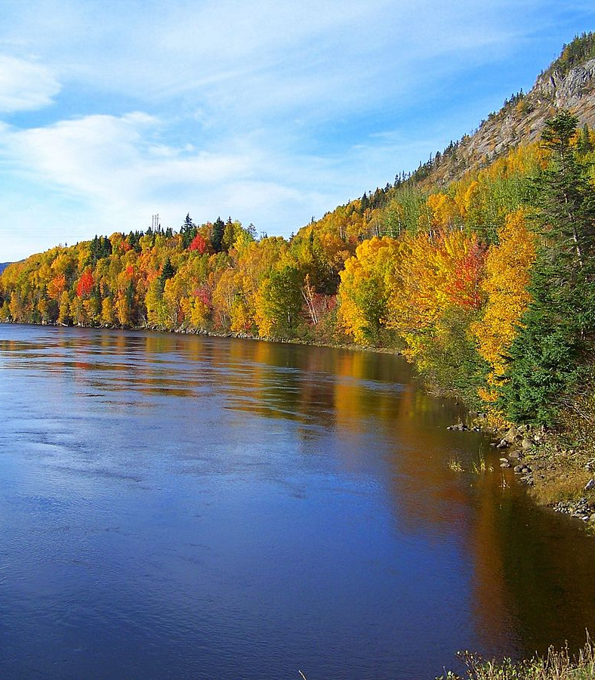
Environmental stewardship
  Release from Environmental Assessment with conditions issued April 19, 2024, pursuant to the Newfoundland and Labrador Environmental Protection Act.
  No Impact Assessment required under federal legislation.
Operating Responsibly
Environmentally Responsible Design
Use of covered and enclosed conveyer, dust collection systems to prevent dust, noise, for the protection of public health.
Conveyor burial and enclosure, water management plan, site design to limit environmental interaction.
Operations will integrate monitoring and avoidance for project site and access routes to protect flora and fauna, natural habitats, and water resources, with adaptive management responsive to any changes.
Benign mining operations with no chemical use or tailings generation minimizes potential impacts.
Active part of the community, working with and making positive contributions to communities in which we operate.
Regular monitoring and adaptive management plans to ensure ongoing environmental stewardship and preservation of biodiversity throughout life of mine.
Proactive environmental design incorporates layout and technologies to minimize impact.
Sustainable Land Use
Ecosystem restoration commitments and closure plans for reclamation and rehabilitation post-mining.
Baseline environment and biodiversity assessments to guide development and construction.
Minimal site footprint over life of mine.
13

Slide 14
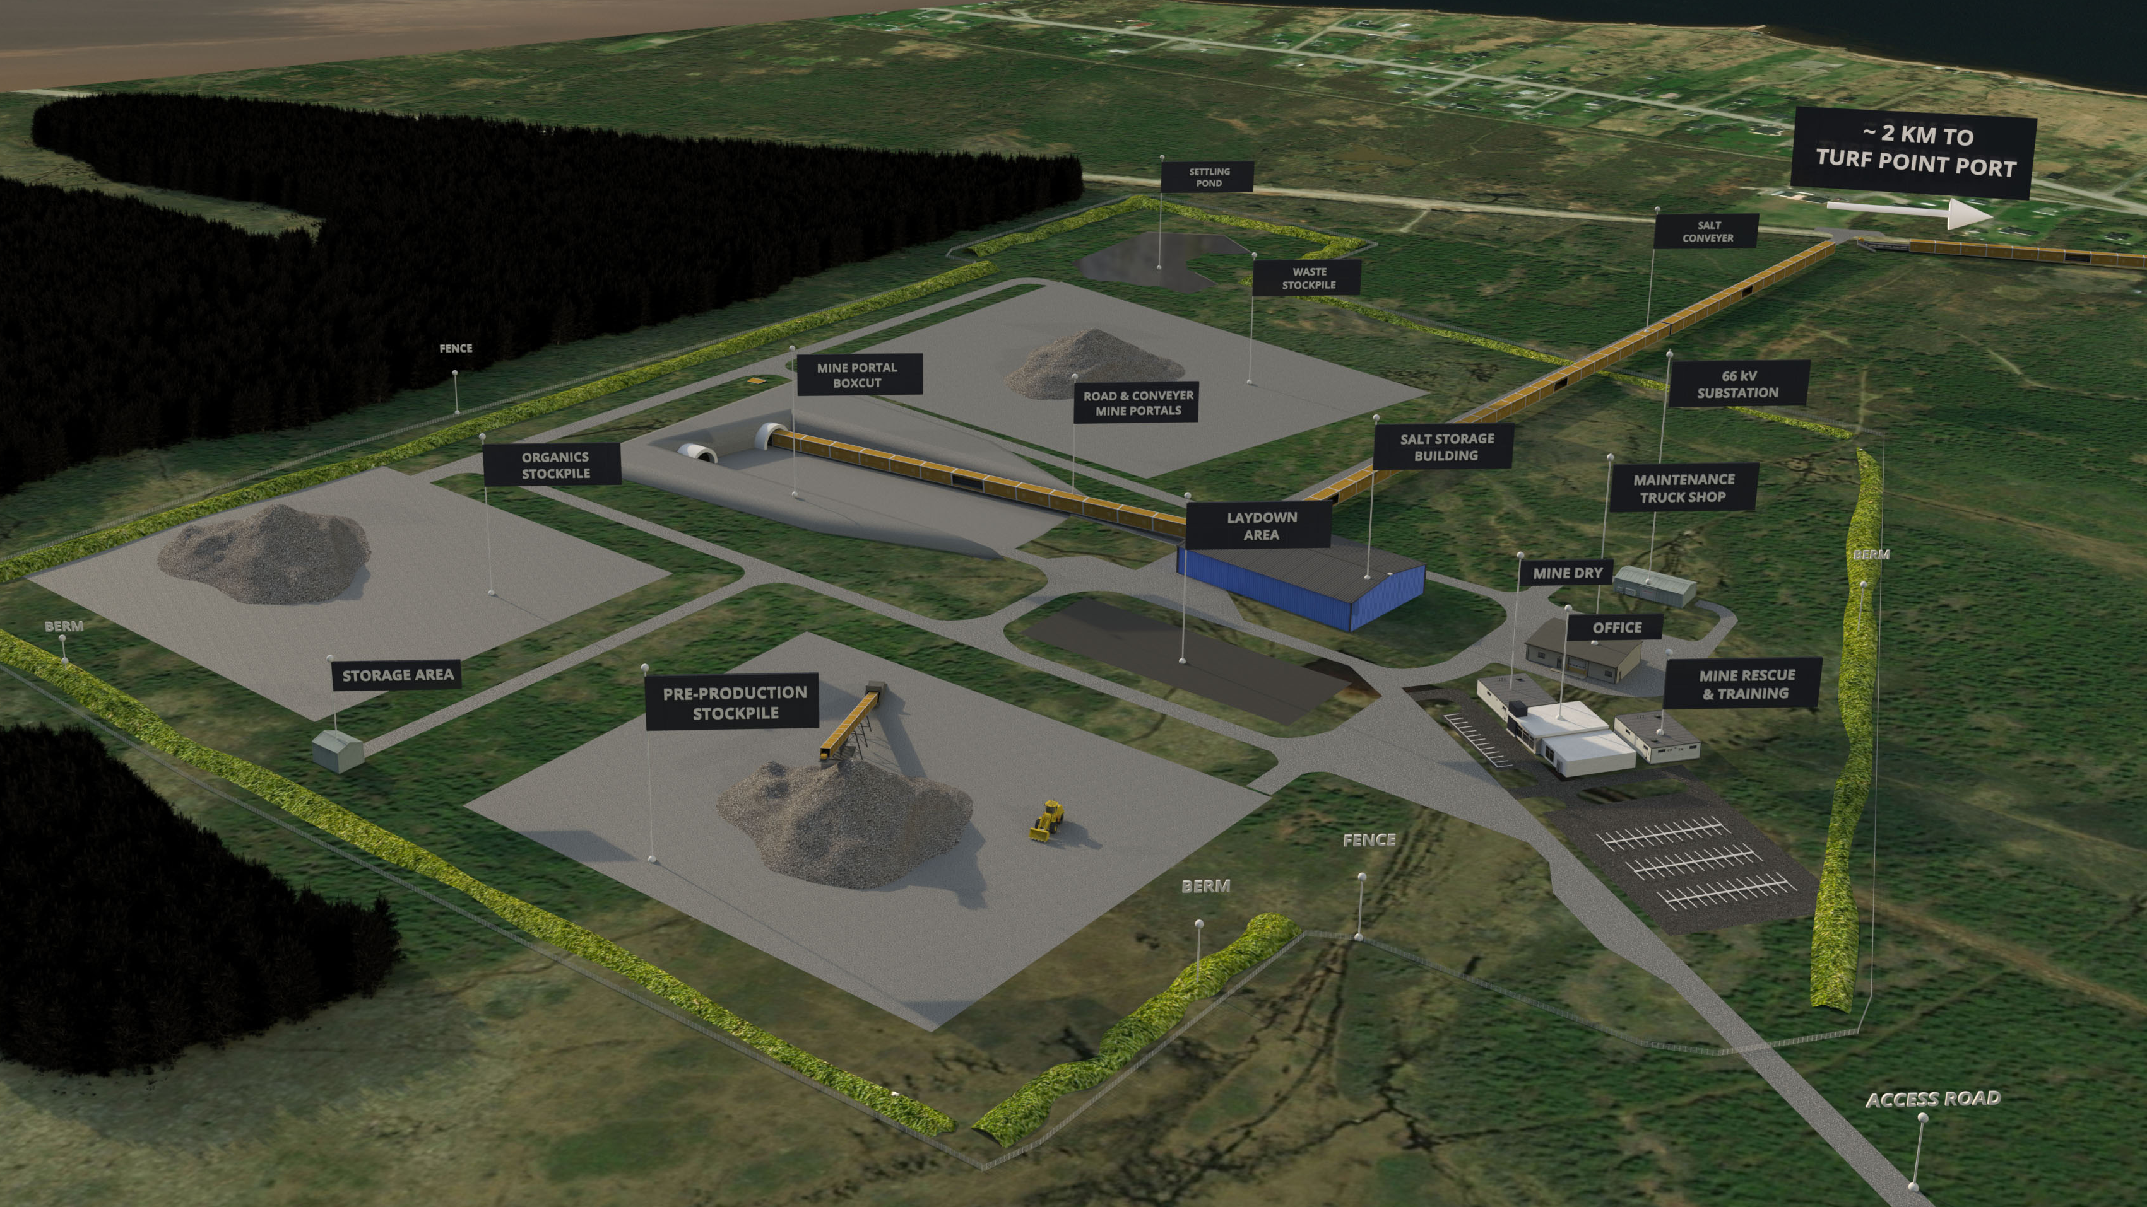
Site footprint – the vision
TSXV: SALT | OTCQB: REMRF | FSE: 9D00

Slide 15
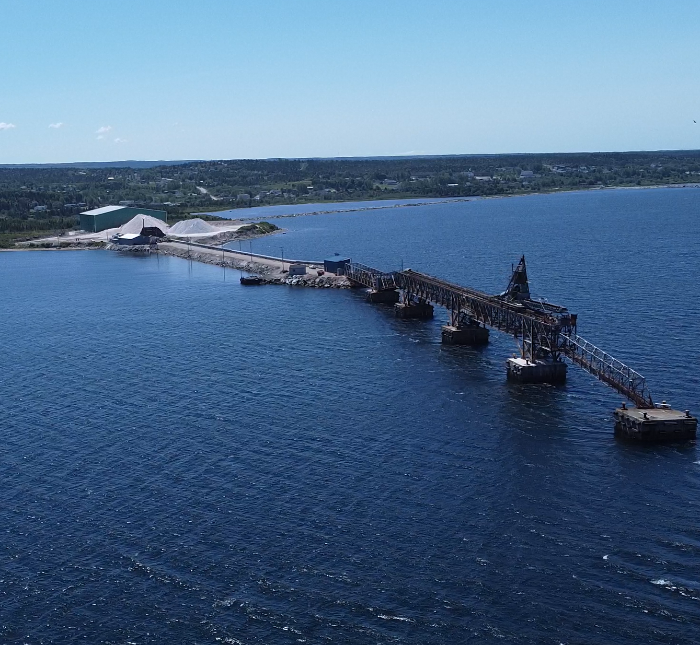
Strategically located
Access to Major Markets
  Proximity to Key Markets
    US East Coast, Québec, New England, Maritime Provinces
  Competitive Edge:
    Reduced transport time and costs
    Industry leading GHG emissions
Existing, Quality Infrastructure
  Trans-Canada Highway
    3 km route to Trans-Canada hwy
  Integrated Oreflow Logistics
    Automated conveyance to the Port
  Electrical Supply Proximity
    1.4km to site, 66 kV line w/ capacity​
  Dedicated Port Facility
    2KM from Turf Point port
15

Slide 16

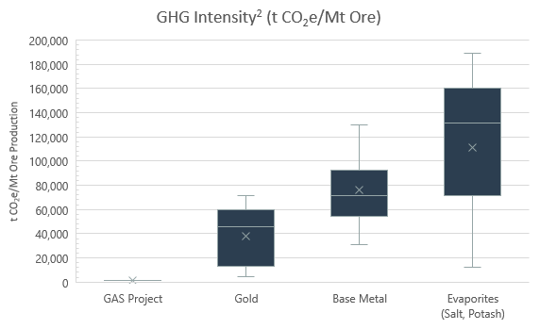
Sustainable mining
Best-in-industry GHG Intensity
  GHG study¹ completed by Stantec in January 2024
Highlights
  Direct Emissions (Scope 1)
    79 t CO2e/yr
  Indirect Emissions (Scope 2)
    2,293 t CO2e/yr
  GHG Emission Intensity
    Approx. 950 t CO2e/Mt of production
    Significantly lower GHG intensity vs. peers
    Comparable scope 1 emissions to the annual carbon footprint expected from four Newfoundland families of four³
950
  Electric Fleet
    Extensive use of Battery Electric Vehicles (BEV)
  Expansion Case Potential
    Increasing throughput further reduces GHG Intensity/Mt
¹ GHG Study prepared by Stantec Consulting Ltd. for the Great Atlantic Salt Project effective January 8, 2024.
² GHG Intensity industry comparison prepared by BWB Consulting Services Inc.
³ According to Statistics Canada (2023) (source: https://www150.statcan.gc.ca/n1/daily-quotidien/231220/mc-c001-eng.htm).

Slide 17
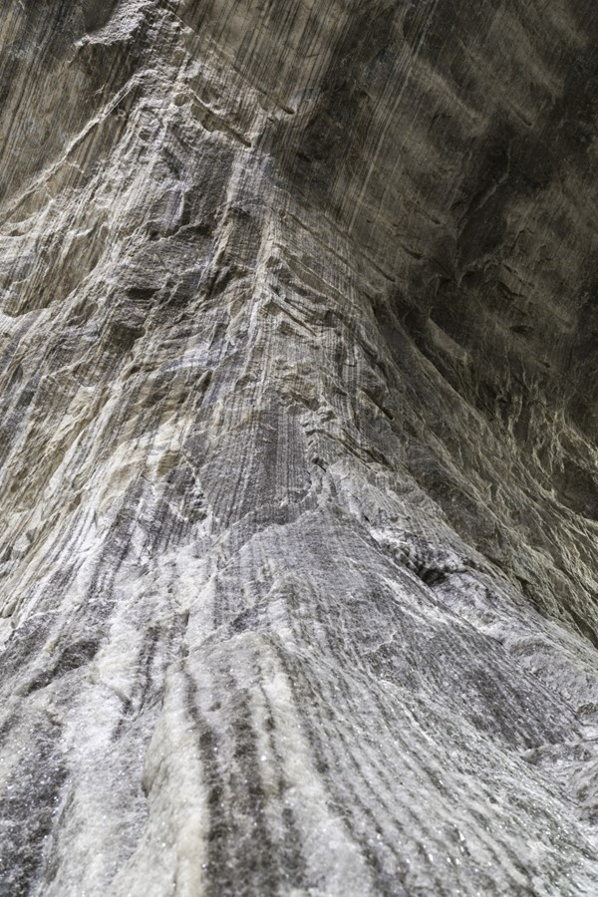
Capital structure
Share Structure as
of December 31, 2024
Outstanding: 96,967,117
Options: 4,000,000
Warrants: 2,850,000
Incentive Plan Units: 2,151,070
Fully diluted: 105,968,187
Average weighted price of warrants is $2.40. Average weighted price of options is $0.80.
17

Slide 18




Responsible leadership
Management Team
Board of Directors
Patrick Laracy, LL.B, P.Geo., Chairman & Director
Newfoundland-based professional geoscientist with legal and regulatory expertise.
Founder of Atlas Salt.
CEO & Director of Vulcan Minerals.
Rowland Howe, Director
Engineer & salt mining industry experience.
President of Goderich Port. Former GM for Compass Minerals’ salt mine in Goderich, ON.
Marc Boissonneault, Director
Engineer & mining industry executive
Former Glencore Head of Global Nickel Assets, overseeing nine underground & two open pit operations, along with five new mining projects.
Director of Frontier Lithium.
Fraser H. Edison, Director
Newfoundland-based business executive.
President & Chairman of Rutter Inc.
Board Member of Newfoundland and Labrador Hydro
Former Board Member of Newfoundland & Labrador Liquor Corporation & Atlantic Canada Opportunities Agency.
F. Carson Noel, LL.B., Director
Newfoundland-based business executive.
Founding director of Ecuador-Canada Chamber of Commerce.
Government & community relations expertise
Richard LaBelle, CEO & Director
Richard LaBelle,
CEO & Director
Engineer & mining industry executive with 40+ years experience
Former President & CEO of Dumas Mining
Underground construction and operational experience, alongside transformational M&A
Robert Booth,
VP, Eng. & Construction
Engineer & mining industry executive with 30+ years experience
Successful project & operational roles with Newmont, Vale & Hudbay
Executed over $1.5B over the past 10 years in underground construction capital projects
Alasdair Federico,
CFO
Lawyer & mining industry executive with 20+ years experience
Former EVP Corp Affairs & Social Responsibility for Kirkland Lake Gold
Experience working with publicly traded mining companies on strategic planning, reporting and compliance programs, company controls, and risk management.
Andrew Smith,
Mine Project Manager
Engineer & mine construction specialist with 10+ years experience
Former head of Project Management at Dumas Mining
Managed over $500M in underground mine building projects

Slide 19
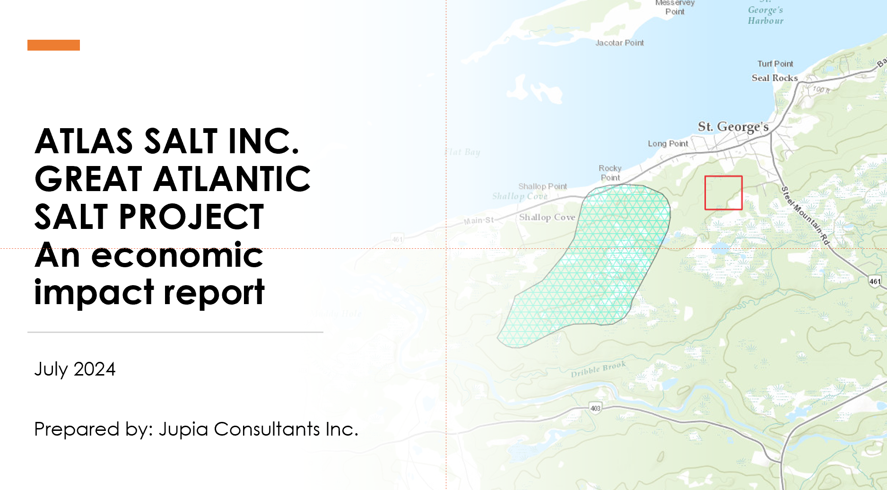
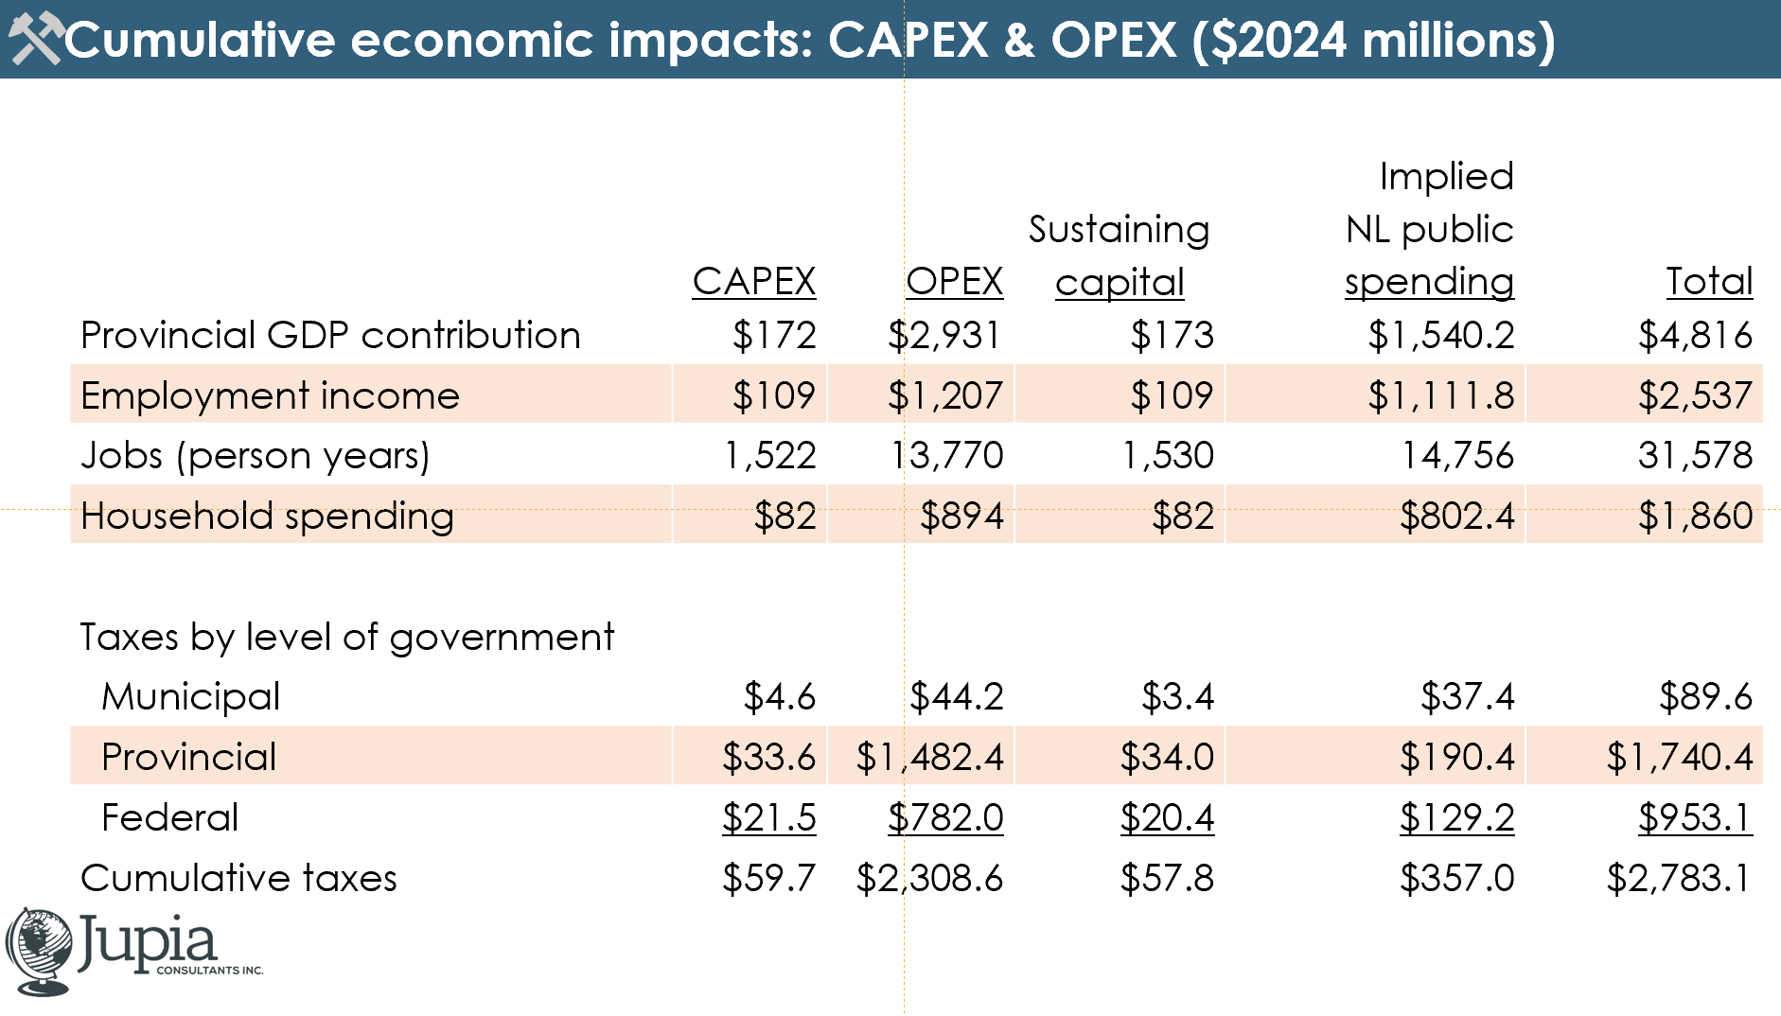
Economic impact
Independent Economic Impact Report and Model finalized by Jupia Consultants Inc. in July 2024
Significant direct, indirect and induced effects over the life of the Project¹:
Boosting NL GDP by $4.8 billion;
Contributing $2.5 billion in employment income in NL;
Boosting annual household spending in NL by $1.9 billion;
Contributing $90 million in tax revenue to municipal governments in NL; and
Contributing $1.7 billion to the NL government and $953 million to the federal government in Canada.
¹ In real dollars ($2024). As per Jupia Consultants report and economic model dated July 2024. https://www.jupia.ca/

Slide 20
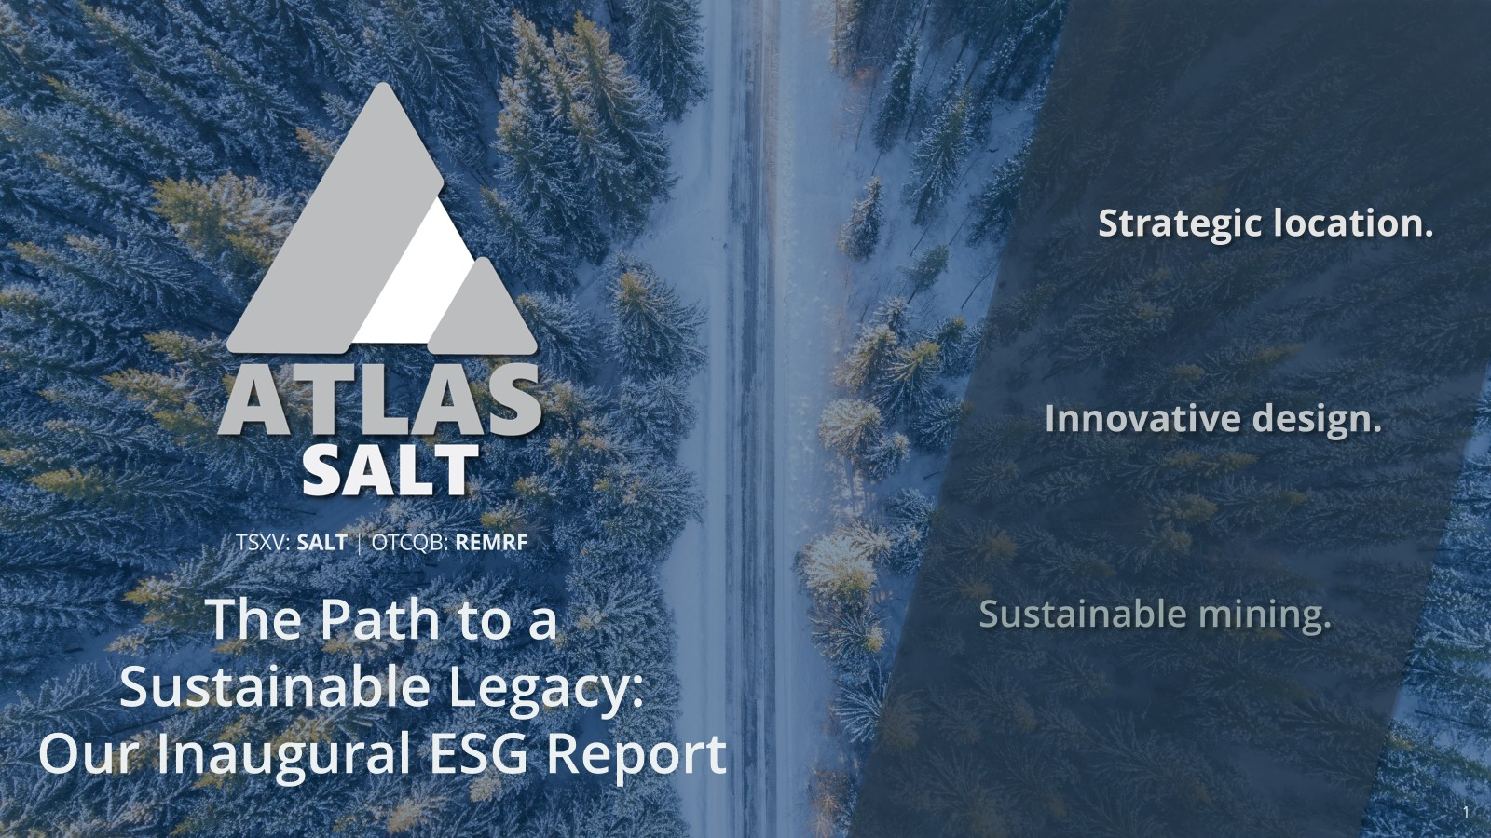
Sustainability
In August 2024, we released The Path to a Sustainable Legacy: Our Inaugural ESG Report.
The Report highlights Atlas Salt’s commitment to upholding core values of environmental stewardship and community engagement while focusing on innovative and sustainable mining.
Maintaining Social License
We are building the social license to operate through engagement right from the planning stage with all key partners for the Project, with the goal of building long-term, mutually beneficial relationships
Developing Market for Clean Salt
We know that demand for de-icing salt currently outstrips domestic supply, so we are focused on identifying bulk and packaged clients who value purchasing clean, low-carbon salt, and who will partner with us to support our sustainable mining practices.
Minimizing Impact
Minimizing greenhouse gas (GHG) emissions and operating sustainably are at the heart of our business. The salt that we will extract will be mined with state-of-the-art electric equipment powered from the provincial grid, occupying very little surface area compared to other mining operations.

Slide 21
Additional Information
Atlas Salt Inc.
TSXV: SALT | OTCQB: REMRF | FSE: 9D00

Slide 22

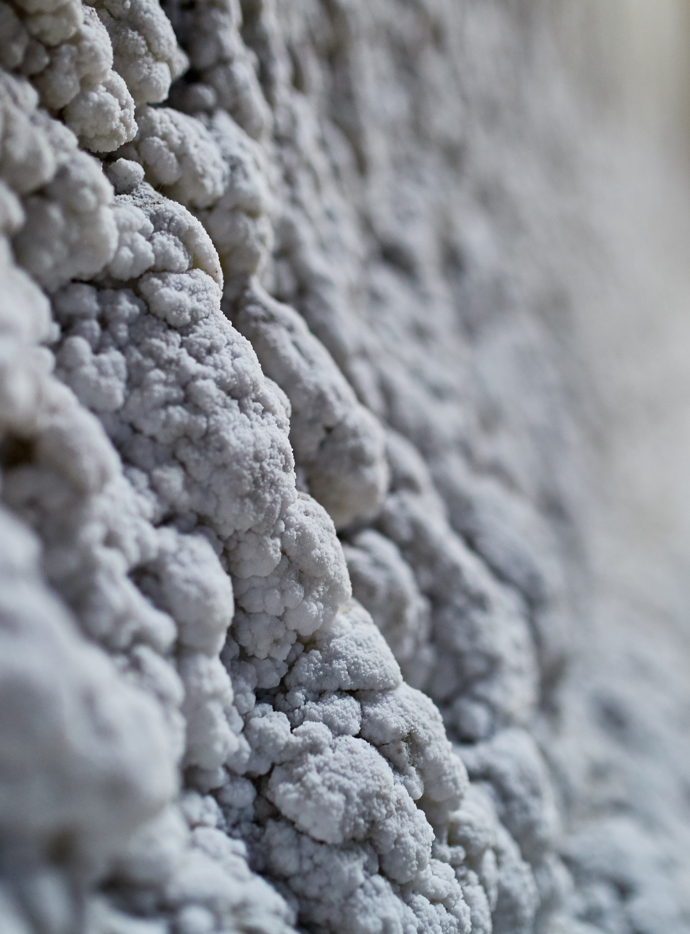
Resources & Reserves
Reserve Class | Grade (% NaCl) | Tonnes (Mt) | Contained NaCl (MT)
Probable | 96.0 | 88.1 | 84.5
Notes:
CIM (2014) definitions were followed for Mineral Reserves.
All Mineral Reserves are classified as Probable Mineral Reserves, with extents limited to the Indicated Mineral Resource wireframe.
Salt prices are not directly correlated into the Mineral Reserve estimate, however the mean Reserve grades exceed the 95.0% NaCl (± 0.5%) specification outlined in ASTM Designation D632-12 (2012) and based on a detailed salt market review to determine economic viability.
A minimum mining height of 5.0 m and width of 16.0 m were used for production rooms.
Sterilization zones 8.0 m below top of salt and 5.0 m above bottom of salt have been applied.
A mining extraction factor of 100% was applied to all excavations.
Bulk density is 2.16 t/m3.
Planned process recovery is 95%.
Numbers may not add due to rounding.
Resource Class | Grade (% NaCl) | Tonnes (Mt) | Contained NaCl (MT)
Indicated | 96.0 | 383 | 368
Inferred | 95.2 | 868 | 827
Notes:
CIM (2014) definitions were followed for Mineral Resources.
Mineral Resources are estimated without a reporting cut-off grade. Reasonable Prospects for Eventual Economic Extraction were instead demonstrated by reporting within Mineable “Stope” Optimised (MSO) shapes, with a minimum height of 5 m, minimum width of 20 m, length of 40 m, and minimum grade of 90% NaCl, with a 5 m minimum pillar width between shapes.
Bulk density is 2.16 t/m3.
Mineral Resources that are not Mineral Reserves do not have demonstrated economic viability.
Mineral Resources are inclusive of Mineral Reserves.
Salt prices are not directly incorporated into the Mineral Resource MSO minimum target grades, however, the mean Mineral Resource grades exceed the 95.0% NaCl (± 0.5%) specification outlined in ASTM Designation D632-12 (2012).
Numbers may not add due to rounding.
TSXV: SALT | OTCQB: REMRF | FSE: 9D00
22

Slide 23
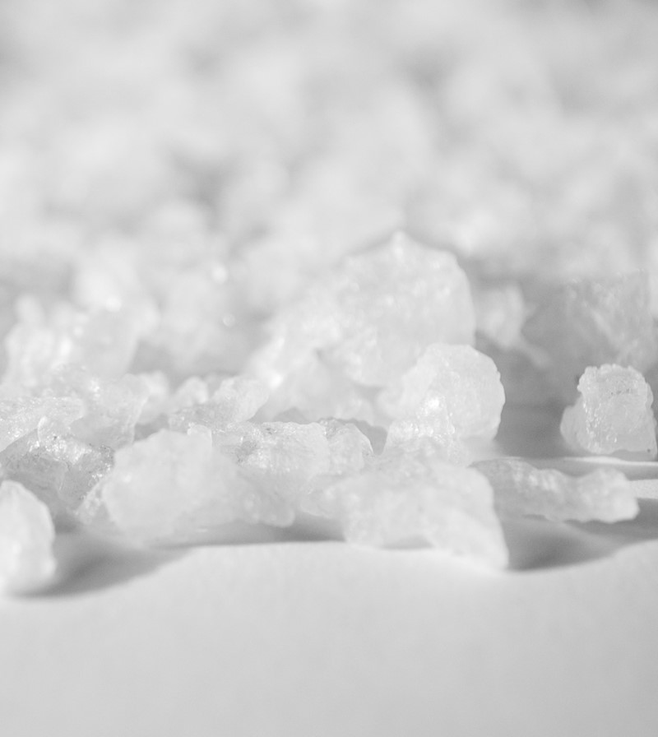
Contact Us
Accents
Text
Atlas Salt Office
100 New Gower Street, Suite 910
St. John's, NL
A1C 6K3
(709) 739-9545
investors@atlassalt.com
Contrast Background
Secondary Text
Atlas Salt Primary Contact
Alasdair Federico
CFO
23

